Slide 1
Welcome Back – Part 6
Jerusalem Is Rebuilt
Ezra, Nehemiah, Esther, Haggai, Zechariah, Malachi

Slide 2
Captives Free to Return
536 BC
Many Israelites stayed where they were
  It has been almost 200 years since the first captives have been taken from Israel.
  722 BC
  The most recent captives have been gone 50 years
    They built homes and were content
    to stay
  It was their choice whether to return or not.

Slide 3
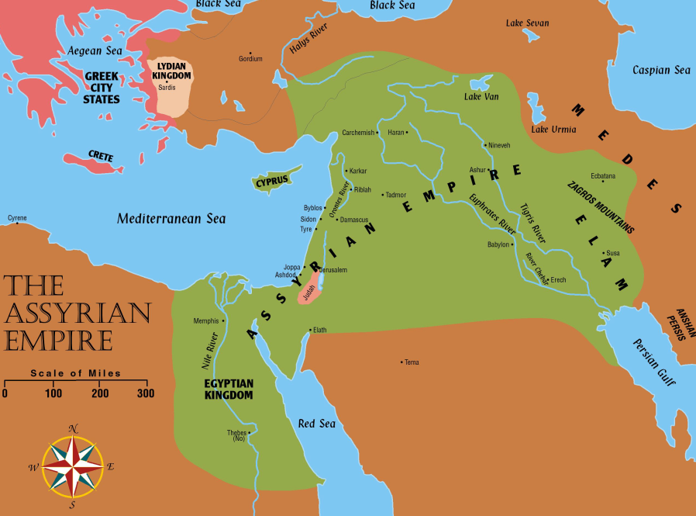
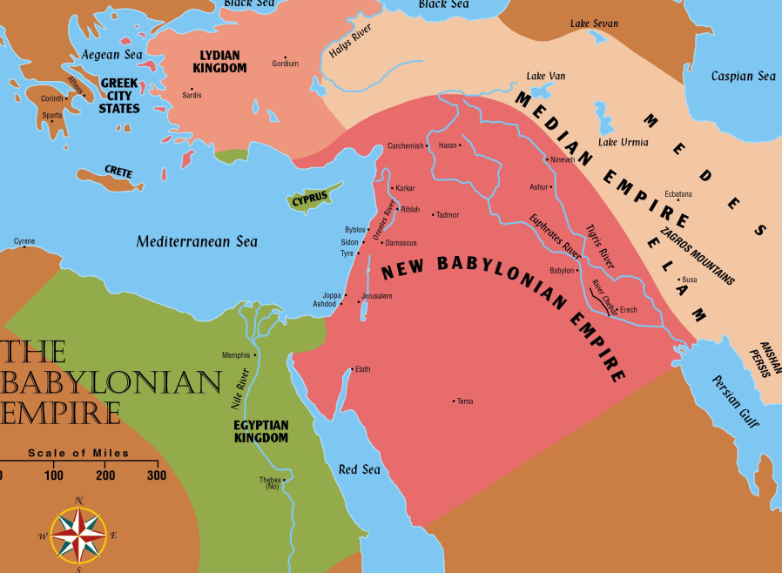
Jerusalem Is Rebuilt
Permission to go home included all the tribes of the Israelites. Ezra 1:3
  Israel (Northern tribes) scattered throughout the Assyrian empire
  Judah (Southern tribes) scattered in Babylon

Slide 4
Background of Haggai, Ezra, Nehemiah, Zechariah, and Malachi
Captivity
606 BC – First captives taken by Nebuchadnezzar.
Daniel 1:1-2
597 BC – Second Group (10,000) taken to Babylon.
2 Kings 24:10-16; Ezekiel 1:1-3
586 BC – Jerusalem falls, temple destroyed.
2 Kings 25:1-21
539 BC – Babylon falls to Medes and Persians.
Daniel 5: 25ff; Isaiah 44:27-45:1-4
Ecclesiastes 7:14 says, “In the day of prosperity be joyful, and in the day of adversity consider.”

Slide 5
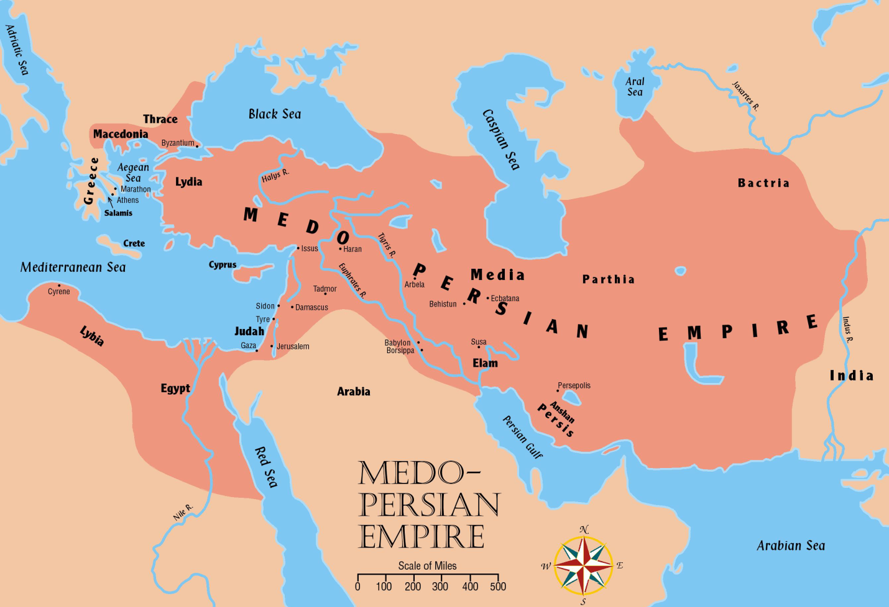
Jerusalem Is Rebuilt
Persia now controls all the territories once held by Assyrian and Babylonian empires

Slide 6
The People of Palestine
They profited from the Jews’ absence
  Samaritans, Ammonites, Edomites and Nomadic tribes moved into and nearer the
  fertile lands
  Adversaries: Samaritans desired to help build the temple. Ezra 4:1ff;
  Nehemiah 2:17ff; cf. 2 Kings 17:32.
  Jews accused of treason. Ezra 4:6ff; 11ff

Slide 7
The “three returns” in Ezra and Nehemiah and Background of Haggai and Nehemiah – Ezra 1-6
Restoration
536 BC – Cyrus issues a decree (538) for the Jews to go back to Jerusalem; after 70 years.
(cf. Jeremiah 25:11; 29:10-14)
  Almost 50,000 return under the leadership of Zerubbabel (2 Chronicles 36:21-23; Ezra 1; 2:64-65)
520-516 BC – The temple is completed.
Ezra 6:15; cf. Ezra 3:10ff; cf. Haggai 2:3
457 BC – Ezra led a second remnant of 2,058 Jews to Jerusalem. Ezra 8:1-34
444 BC – Nehemiah lead a third remnant back.
Nehemiah 2

Slide 8
Persian Kings
These rulers cover the period of restoration during the time of: Ezra, Nehemiah, Esther, Haggai, Zechariah, and Malachi.
Cyrus (559-529) Conquered Babylon in 539 BC with Darius the Mede. Daniel 5:30-31
Cambyses (529-522) Also called “Artaxerxes” Commanded work on the temple to cease.
Ezra 4:7, 11, 23

Slide 9
Persian Kings
These rulers cover the period of restoration during the time of: Ezra, Nehemiah, Esther, Haggai, Zechariah, and Malachi.
Darius I (522-486) Authorized the completion of the temple. Ezra 4:24-6:15, Book of Haggai
Xerxes (485-465) Also called “Ahasuerus” – Esther was his queen, Book of Esther.
Artaxerxes (465-425) Authorized Nehemiah to rebuild Jerusalem, Ezra 7; Book of Nehemiah.

Slide 10
Welcome Back
Esther – Takes place approximately between chapters 6 and 7 of the book of Ezra.
Haggai – “Consider Your Ways”
Nehemiah – A Man Of Action
Malachi – Would He Be Heard Today?

Slide 11
445-432 BC – Malachi writes about faithfulness to the Lord.
Restoration
About 100 years after the restoration.
2nd and 3rd generation descendants had begun to lose sight of serving the Lord and wholehearted zeal.
Worship was in decay, priests were careless regarding sacrifices. (1:6-8, 13; 2:9)
Tithing had been neglected. (3:9-10)
Indifference and skepticism characterized the nation as a whole. (3:14; 2:17)
Divorce and intermarriage with the Gentile women was common. (2:11-16)

Slide 12
Similarities of the Writings of Nehemiah and Malachi
1. Marriage of heathen wives.
(Malachi 2:11-15 and Nehemiah 13:23-27)
2. Neglect in paying the tithes.
(Malachi 3:8-10 and Nehemiah 13:10-14)
3. Disregard of the Sabbath.
(Malachi 2:8-9 and Nehemiah 13:15-22)
4. Corruption of the priesthood.
(Malachi 1:6-2:9 and Nehemiah 13:7-9)
5. Existence of social wrong.
(Malachi 3:5 and Nehemiah 5:1-13)

Slide 13
Ye say … “Wherein hast thou loved us?” Malachi 1:2
The Lord’s Answer:
I chose Jacob (descendants) over Esau. 1:2-4; cf. Genesis 25:23
In the sure knowledge of being the “apple of his eye” (Deuteronomy 32:10;
Psalms 17:8)
NOTE: God restored Israel, but refused to restore Edom. Jeremiah 49:7-22;
cf. Obadiah; cf. John 3:16; Ephesians 1:3ff; Romans 9:8-13

Slide 14
Ye say … “Wherein have we despised thy name?”
Malachi 1:6
Ye say … “Wherein have we polluted thee?”
Malachi 1:7
The Lord’s Answer:
You offer polluted bread; in weariness. 1:7, 13
(cf. Revelation 3:15-17)
Faithless priests rebuked. cf. Deuteronomy 15:21
Gentiles would give honor and great sacrifices. 1:11; cf. Romans 9:24-26; 10:1-3, 20-21
Curse pronounced. 2:1-9
  Responsibilities: Keep the covenant. Teach the law. Observe sacrifices.
cf. Elders, preachers, etc. (cf. Ezekiel 34; Acts 20:29-30)

Slide 15
Ye say, “Wherefore?” (Why is God displeased with us?) Malachi 2:10-14
The Lord’s Answer:
You divorced your wives and “married the daughter of a foreign god.” Malachi 2:11, 13, 16; Genesis 2:18; Matthew 19:1-9; Matthew 14:1; Mark 6:16-18

